Slide 1
FIDO2 – Strong authentication for the WEB

Slide 2
About me
Romain Poulain
With 2BIT since July 2019
.NET/Angular developer
Not an expert in FIDO2
Not security expert

Slide 3
The plan
What is FIDO/WebAuthn?
Why use it
Requirements
Registration process
Authentication process
Code demo
MDS
Account recovery
Questions/discussion

Slide 4
What is FIDO2/WebAuthn?
FIDO (Fast Identity Online)
The FIDO Alliance is an open industry association with a focused mission: authentication standards to help reduce the world’s over-reliance on passwords
FIDO2
WebAuthn (Web Authentication API)
A browser API that specifies an interface for managing public key credentials
Extension of the Credential Management API
CTAP2 (Client To Authenticator Protocol v2)
Set of low level protocols to communicate with authenticators (over BLE, USB, NFC)
Second version of the CTAP family
Backward compatible with CTAP1 (aka U2F)

Slide 5
Why use it?
Increases security
Multi factor authentication
Bulletproof phishing protection, origin is part of the credential
Prevent replay attacks, challenge + counter
No shared secrets (unlike OTP)
Credentials are store on the key, not on the RP
Reduce friction
No need to remember/manage passwords, just use your key or TPM
Easy backup, just register multiple keys

Slide 6
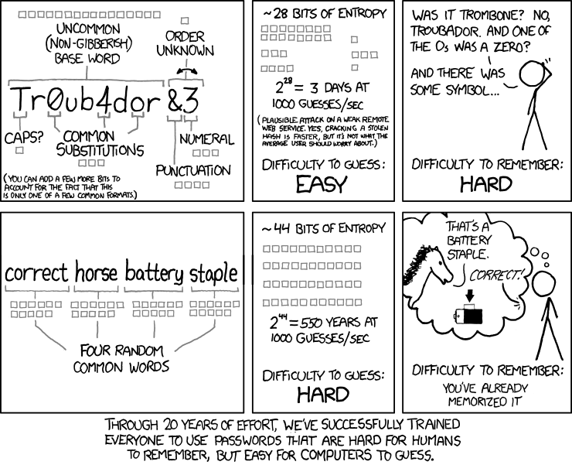
https://xkcd.com/936/

Slide 7
Requirements
HTTPS
HTTP only allowed for localhost
Authenticator
TPM
Roaming
Supported browser
https://caniuse.com/#feat=webauthn
Supported platform or authenticator
https://fidoalliance.org/certification/fido-certified-products/

Slide 8
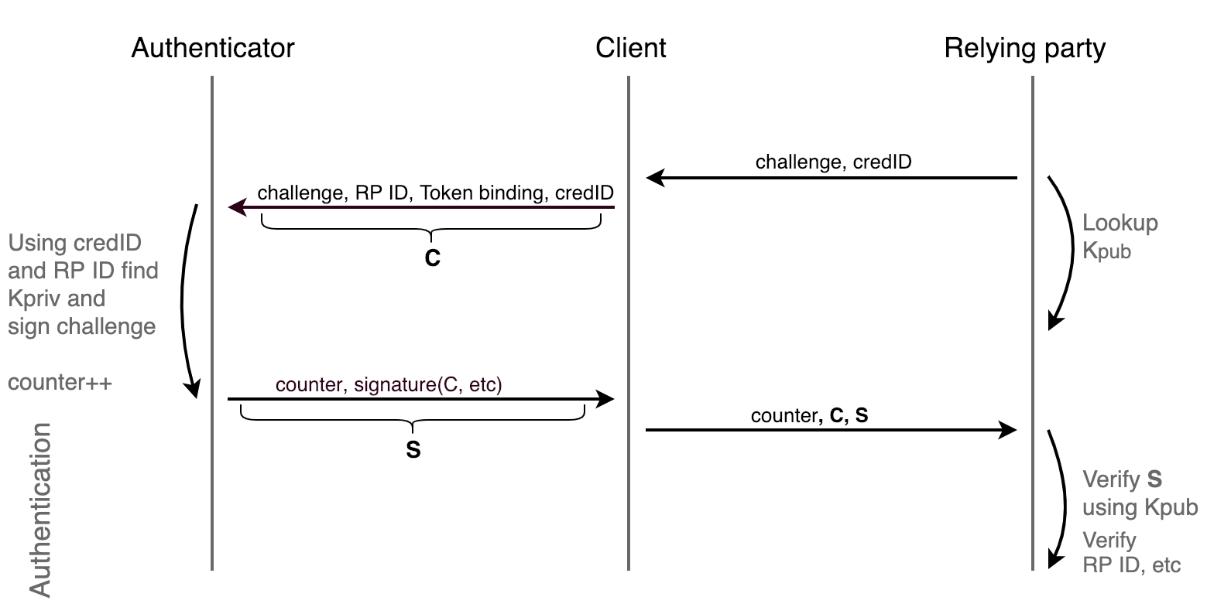
Register Ceremony

Slide 9
Register PublicKeyCredentialCreationOptions
challenge random challenge generated by the server, used to replay attacks
rp.name relying party friendly name
rp.id relying party identifier
user.id RP’s generated user id, mainly to relate credential to the user account on the RP
user.name RP’s primary user identifier (e.g. username, email, phone number)
pubKeyCredParams list of signing algorithms that server is supporting (e.g. RS1, RS256 ES256, etc.
{
"rp": {
"id": "localhost",
"name": "Meetup Demo Webauthn"
},
"user": {
"name": "Alice",
"id": <buffer source>,
"displayName": "Display Alice"
},
"challenge": <buffer source>,
"pubKeyCredParams": [
{ "type": "public-key", "alg": -7 },
…
],
"timeout": 60000,
"attestation": "direct",
"authenticatorSelection": {
"requireResidentKey": false,
"userVerification": "preferred"
},
"excludeCredentials": []
}

Slide 10
Register PublicKeyCredentialCreationOptions
{
"rp": {
"id": "localhost",
"name": "Meetup Demo Webauthn"
},
"user": {
"name": "Alice",
"id": <buffer source>,
"displayName": "Display Alice"
},
"challenge": <buffer source>,
"pubKeyCredParams": [
{ "type": "public-key", "alg": -7 },
…
],
"timeout": 60000,
"attestation": "direct",
"authenticatorSelection": {
"requireResidentKey": false,
"userVerification": "preferred"
},
"excludeCredentials": []
}
excludeCredentials list of credentials already registered to the user, given to the authenticator to prevent double registration
authenticatorSelection.authenticatorAttachment type of the authenticator you enforce, “platform” for only built-in authenticators, “cross-platform” for only external security keys
authenticatorSelection.requireResidentKey force Resident Credential
Notes:
The resident credential is a credential that can be accessed simply with RPID. So if generally when you call GetAssertion, you will have to provide “allowList” that will contain credential identifier. With the RK you don’t need it since the authentication will locate all RK(only RK credentials), and for each of them generate the assertion over the challenge and return all of them to the client. The client then will display all of the credentials to the user and user will pick one, thus returning selected credential to the relying party.

Slide 11
Register PublicKeyCredentialCreationOptions
{
"rp": {
"id": "localhost",
"name": "Meetup Demo Webauthn"
},
"user": {
"name": "Alice",
"id": <buffer source>,
"displayName": "Display Alice"
},
"challenge": <buffer source>,
"pubKeyCredParams": [
{ "type": "public-key", "alg": -7 },
…
],
"timeout": 60000,
"attestation": "direct",
"authenticatorSelection": {
"requireResidentKey": false,
"userVerification": "preferred"
},
"excludeCredentials": []
}
authenticatorSelection.userVerification user verification requirement, “required” enforce UV (ClientPin, biometrics, etc), “preferred” try UV then enforce TUP (press a button), “discouraged” only enforce TUP
attestation “direct” for full attestation, “none” for no attestation, “indirect” RP prefers verifiable attestation but allows the client to decide how to obtain it

Slide 12
Register PublicKeyCredential raw
{
"id": "X9FrwMfmzj...",
"response": {
"attestationObject": "o2NmbXRoZmlk...",
"clientDataJSON": "eyJjaGFsbGVuZ..."
},
"clientExtensionResults": {}
}
id credential identifier
response credential public key, and metadata which can be used by the RP to assess the characteristics of the credential
attestationObject contains the authenticator data and attestation statement
clientDataJSON contains the JSON-serialized data passed to the authenticator by the client to generate the credential

Slide 13
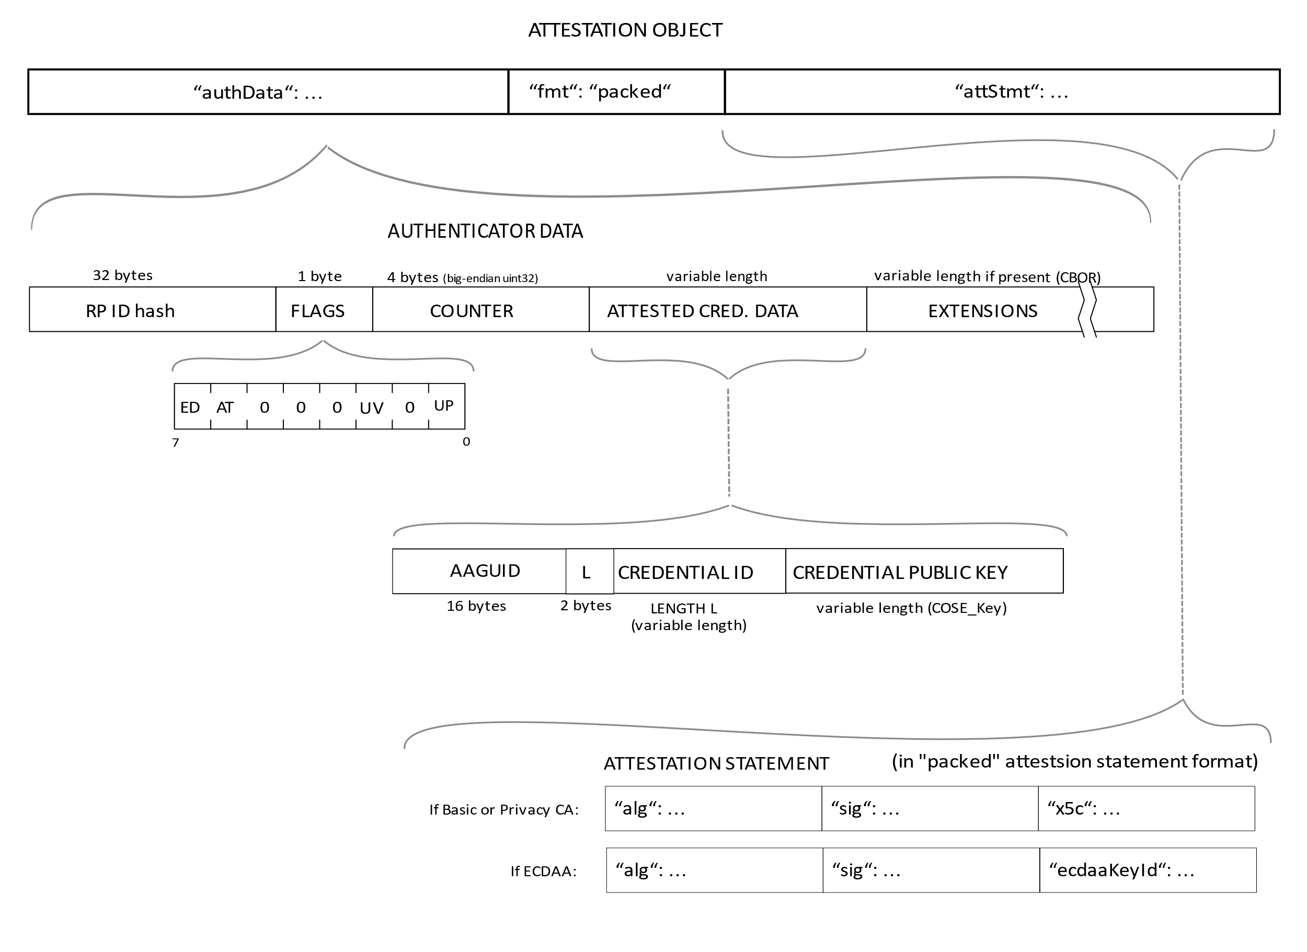
Register attestationObject structure

Slide 14
Register attestationObject parsed
{
"attStmt": {
"alg": -7,
"sig": "MEUCIQD1...",
"x5c": ["MIICvDCCA..."]
},
"authData": {
"credentialData": {
"aaguid": "-iuZ3J45QlePkkow0jxBGA==",
"credentialId": "X9FrwMfmzj...",
"publicKey": { "1": 2, "3": -7, "-1": 1, ... }
},
"flags": {
"AT": true, "ED": false, "UP": true, "UV": false
},
"rpIdHash": "xGzvgq0bVGR3WR0…R0v-ppaZJdA7c=",
"signatureCounter": 7
},
"fmt": "packed"
}
alg COSE Algorithm identifier
sig attestation signature
x5c attestation certificate and its certificate chain
authData data about the make credential operation like credential ID and public key
credentialData credential data attested by the authenticator
Notes:
CBOR Object Signing and Encryption (COSE)

Slide 15
Register attestationObject parsed
{
"attStmt": {
"alg": -7,
"sig": "MEUCIQD1...",
"x5c": ["MIICvDCCA..."]
},
"authData": {
"credentialData": {
"aaguid": "-iuZ3J45QlePkkow0jxBGA==",
"credentialId": "X9FrwMfmzj...",
"publicKey": { "1": 2, "3": -7, "-1": 1, ... }
},
"flags": {
"AT": true, "ED": false, "UP": true, "UV": false
},
"rpIdHash": "xGzvgq0bVGR3WR0…R0v-ppaZJdA7c=",
"signatureCounter": 7
},
"fmt": "packed"
}
aaguid An identifier chosen by the authenticator manufacturer, indicating the make and model of the authenticator
credentialId identifier generated by the authenticator
publicKey credential public key encoded in COSE_Key format
Notes:
CBOR Object Signing and Encryption (COSE)

Slide 16
Register attestationObject parsed
{
"attStmt": {
"alg": -7,
"sig": "MEUCIQD1...",
"x5c": ["MIICvDCCA..."]
},
"authData": {
"credentialData": {
"aaguid": "-iuZ3J45QlePkkow0jxBGA==",
"credentialId": "X9FrwMfmzj...",
"publicKey": { "1": 2, "3": -7, "-1": 1, ... }
},
"flags": {
"AT": true, "ED": false, "UP": true, "UV": false
},
"rpIdHash": "xGzvgq0bVGR3WR0…R0v-ppaZJdA7c=",
"signatureCounter": 7
},
"fmt": "packed"
}
flags AT authenticator added attested credential data, ED authenticator data has extensions, UP user is present, UV user is verified
rpIdHash SHA-256 hash of the RP ID the credential is scoped to

Slide 17
Register attestationObject parsed
{
"attStmt": {
"alg": -7,
"sig": "MEUCIQD1...",
"x5c": ["MIICvDCCA..."]
},
"authData": {
"credentialData": {
"aaguid": "-iuZ3J45QlePkkow0jxBGA==",
"credentialId": "X9FrwMfmzj...",
"publicKey": { "1": 2, "3": -7, "-1": 1, ... }
},
"flags": {
"AT": true, "ED": false, "UP": true, "UV": false
},
"rpIdHash": "xGzvgq0bVGR3WR0…R0v-ppaZJdA7c=",
"signatureCounter": 7
},
"fmt": "packed"
}
signatureCounter incremented for each successful authenticatorGetAssertion operation, used to detect cloned authenticators
fmt attestation statement format identifier as detailed in the W3C WebAuthn spec (e.g. packed, fido-u2f format, etc…)

Slide 18
Register ClientDataJSON parsed
{
"challenge": "qNqrdXUrk5S7dCM1MAYH3q...GqiACR10",
"origin": "http://localhost:4200",
"type": "webauthn.create"
}
challenge sent by the RP
origin domain observed by the client
type operation performed

Slide 19
Authentication verify response
Verify challenge
Verify origin
Verify credentials are not already assigned to another user
…
https://www.w3.org/TR/webauthn/#registering-a-new-credential
Save CredentialId, PublicKey and any parameter necessary to you policy (attestation, counter, etc..)

Slide 20
Authentication Scenarios
2 FA
Password less
Username less (Resident Credentials)

Slide 21
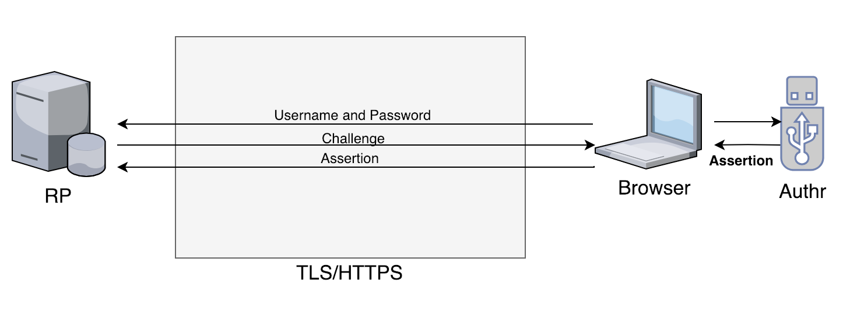
Authentication Ceremony – 2FA

Slide 22
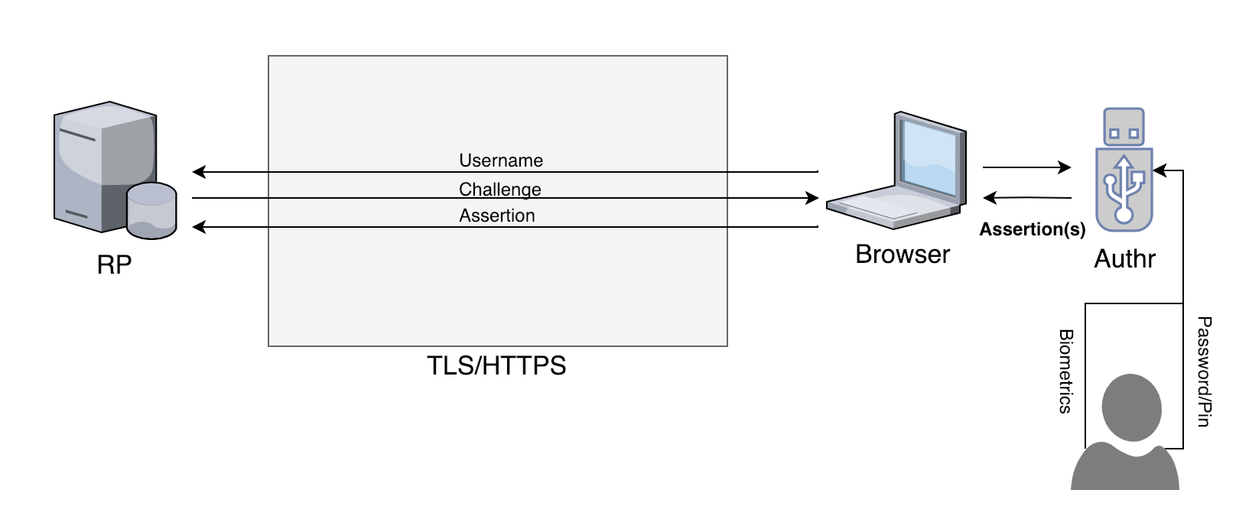
Authentication Ceremony – Password less

Slide 23
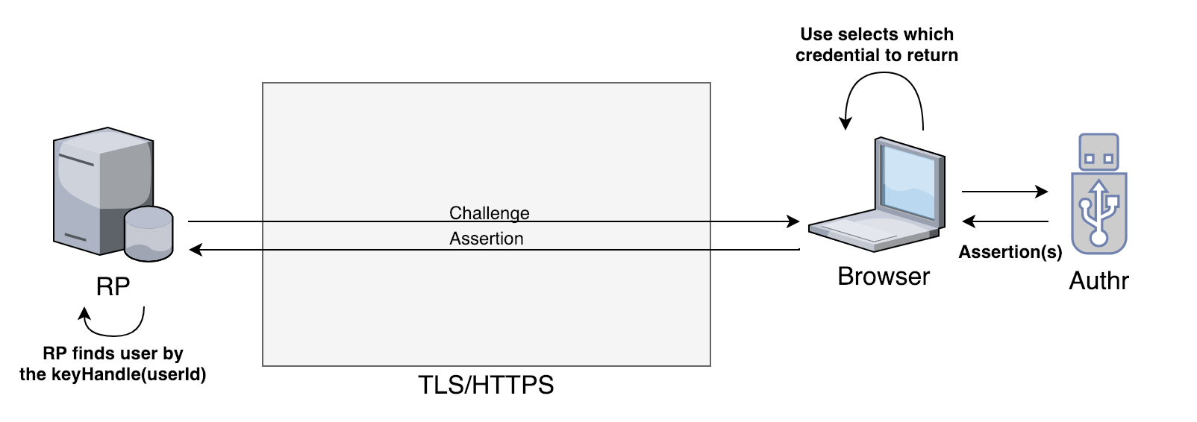
Authentication Ceremony – Username less

Slide 24
Authentication PublicKeyCredentialRequestOptions
{
"allowCredentials": [
{
"id": <buffer source>,
"type": "public-key"
}
],
"challenge": <buffer source>,
"rpId": "localhost",
"timeout": 30000,
"userVerification": "discouraged"
}
allowCredentials list of public key credentials acceptable to the RP
challenge random challenge generated by the server, used to replay attacks
rpId relying party identifier claimed by the caller, must match the rp.id specified during registration
userVerification “required” enforce UV, “preferred” try UV then enforce TUP, “discouraged” only enforce TUP

Slide 25
Authentication assertionObject parsed
id credential identifier
response metadata the RP needs to validate the assertion
authenticatorData contains the authenticator data about the get credential operation
clientDataJSON JSON-serialized data passed to the authenticator by the client
signature raw signature returned from the authenticator
clientExtensionResults() returns values for zero or more WebAuthn extensions
{
"id": "X9FrwMfmzj...",
"response": {
"authenticatorData": "xGWsdR0A.A7cBAAAACA",
"clientDataJSON": "eyJjaGFsbG...",
"signature": "MEUCIQDNrG..."
},
"clientExtensionResults": {}
}

Slide 26
Authentication authenticatorData parsed
{
"authData": {
"flags": {
"AT": false,
"ED": false,
"UP": true,
"UV": false
},
"rpIdHash": "xGzv...A7c=",
"signatureCounter": 8
}
}
flags AT authenticator added attested credential data, ED authenticator data has extensions, UP user is present, UV user is verified
rpIdHash SHA-256 hash of the RP ID the credential is scoped to
signatureCounter incremented for each successful authenticatorGetAssertion operation, used to detect cloned authenticators

Slide 27
Authentication clientDataJSON parsed
{
"challenge": "kYhXBWX0HO5Gst...Z0jZLH7PpC4tzJI-ZcA",
"origin": "http://localhost ",
"type": "webauthn.get"
}
challenge sent by the RP
origin domain observed by the client
type operation performed

Slide 28
Code Demo
Register (Attestation)
Login (Assertion)
RP
.NETCore 2.2 Web API
Fido2 -Version 1.0.1 (NuGeT)
Client
Webauthn API
@types/webappsec-credential-management

Slide 29
MDS
The FIDO Alliance Metadata Service (MDS)
Web-based tool where FIDO authenticator vendors can publish metadata statements for FIDO servers to download
Provides organizations deploying FIDO servers with a centralized and trusted source of information about FIDO authenticators
JWT
JSON Web Token
https://jwt.io/
https://mds2.fidoalliance.org/tokens/
Link to access the TOC

Slide 30
Account recovery
It should be as strong as your authentication
Don't fall back to password
Multiple secure keys
Email
Help desk flow
Keep old credentials for future exclusion

Slide 31
Credits / Source
https://fidoalliance.org/overview/
https://medium.com/@herrjemand/introduction-to-webauthn-api-5fd1fb46c285
https://www.w3.org/TR/webauthn/
https://auth0.com/blog/web-authentication-webauthn-overview-demo-tool/
https://docs.microsoft.com/en-us/microsoft-edge/dev-guide/windows-integration/web-authentication
https://paulstamatiou.com/getting-started-with-security-keys/
https://developers.yubico.com/WebAuthn/WebAuthn_Developer_Guide/WebAuthn_Client_Registration.html

Slide 32
Questions/discussion
?!

